Slide 1
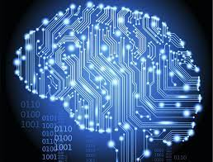
The Group Theory Revolution: Unleashing the Power of Computer Science
Ryan Wickramaratne

Slide 2

Agenda
Introduction
Basic Concepts of Group Theory
Group Theory and Computer Science - A Unique Connection
Group Theory in Data Structures
Group Theory in Cryptography
Group Theory in Computer Graphics
Group Theory in Coding Theory
Group Theory in Quantum Computing
Group Theory in Artificial Intelligence:
Group Theory in Database Theory:
Group Theory in Network Theory:
Group Theory in Game Theory:
Group Theory in Complexity Theory:
Group Theory in the Future of Computing:
Interactive Discussion:
References and Q&A

Slide 3

Introduction
Group theory is a branch of mathematics that deals with the study of symmetry and structure. It has found numerous applications in various fields, including physics, chemistry, and computer science. In this presentation, we will explore the relevance of group theory to computer science and why it is an indispensable tool in this field.
The image on this page shows a group of symmetrical shapes, such as squares and circles, arranged in a pattern. This represents the concept of symmetry, which is a fundamental aspect of group theory.

Slide 4
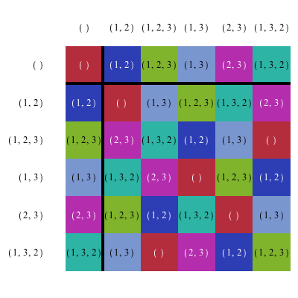
Basic Concepts of Group Theory
In group theory, a group is a set of elements with a binary operation that satisfies certain properties, such as closure, associativity, identity, and inverse. Subgroups are subsets of a group that also form a group under the same operation. Group operations include multiplication, addition, and composition, among others.
The image on this page shows a set of abstract symbols, such as numbers, arranged in a table. This represents the concept of a group table, which is a way of visualizing the group operation and its properties.

Slide 5

Group Theory and Computer Science - A Unique Connection
Group theory and computer science have a unique connection because group theory provides a framework for solving problems in computer science. For example, group theory can be used to optimize data structures, design error-correcting codes, develop secure cryptographic systems, and understand the behavior of quantum systems.
The image on this page shows a computer screen with various programming code snippets. This represents the intersection between group theory and computer science, where mathematical concepts are applied to solve real-world problems in computing.

Slide 6
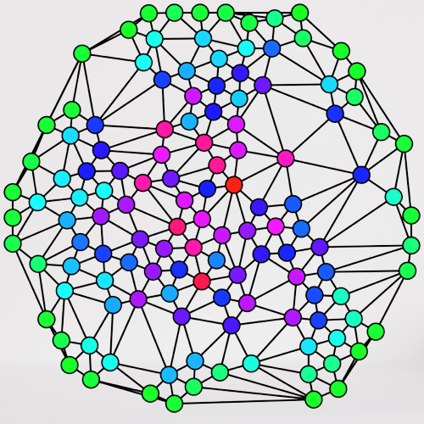
Group Theory in Data Structures
In data structures, group theory can be used to optimize the performance of algorithms by identifying symmetries and redundancies in the data. For example, group theory can be used to identify isomorphic subgraphs in a graph data structure, which can be compressed or eliminated to reduce memory usage and improve search efficiency.
The image on this page shows a graph data structure with nodes and edges, highlighting the concept of isomorphic subgraphs. This represents how group theory can be used to optimize data structures by identifying symmetries and redundancies.

Slide 7

Group Theory in Cryptography
In cryptography, group theory can be used to develop secure cryptographic systems by providing a framework for designing encryption and decryption algorithms that are resistant to attacks. For example, group theory can be used to develop public-key cryptosystems based on the discrete logarithm problem or the elliptic curve discrete logarithm problem.
The image on this page shows a lock and key symbolizing the concept of encryption and decryption in cryptography. The group theory can be used to develop secure cryptographic systems based on mathematical problems that are difficult to solve.

Slide 8

Group Theory in Computer Graphics
In computer graphics, group theory can be used to create complex graphics and animations by identifying symmetries and patterns in the visual elements. For example, group theory can be used to generate fractals, tessellations, and kaleidoscopic images.
The image on this page shows a colorful kaleidoscopic pattern with symmetrical shapes and patterns. This represents how group theory can be used to create visually stunning graphics and animations by identifying and utilizing symmetries and patterns.

Slide 9

Group Theory in Coding Theory
In coding theory, group theory can be used to design error-correcting codes that can detect and correct errors in data transmission. For example, group theory can be used to construct linear codes based on cyclic groups or abelian groups.
The image on this page shows a set of binary digits arranged in a matrix, representing a block code. The group theory can be used to design error-correcting codes that can detect and correct errors in data transmission.

Slide 10
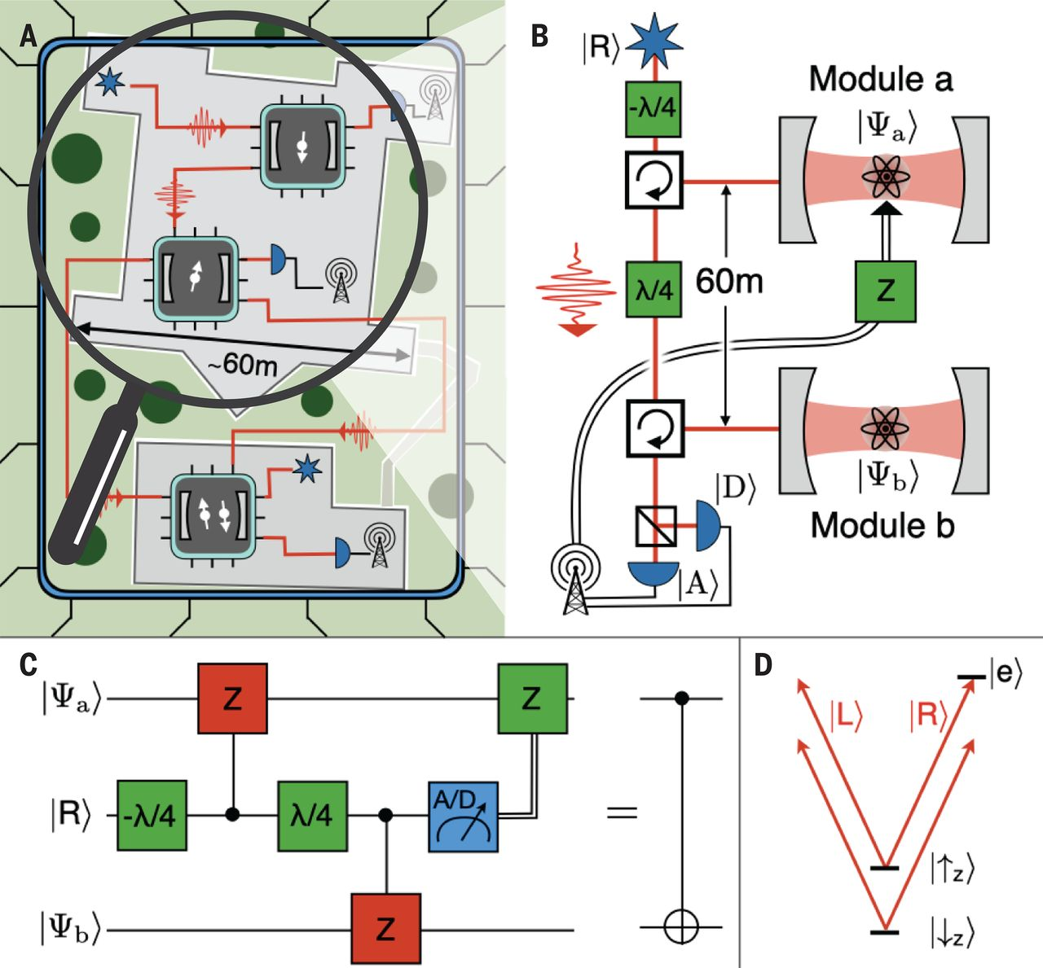
Group Theory in Quantum Computing
In quantum computing, group theory can be used to understand the behavior of quantum systems and develop algorithms that exploit their unique properties. For example, group theory can be used to study the symmetries of entangled states and design quantum error-correcting codes based on stabilizer groups.
The image on this page shows a representation of a quantum circuit with gates and qubits, illustrating the concept of quantum computation. This represents how group theory can be used to understand the behavior of quantum systems and develop algorithms for quantum computation.

Slide 11
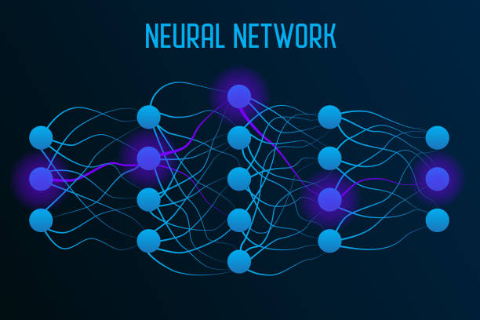
Group Theory in Artificial Intelligence:
Group theory can be used in artificial intelligence to understand the structure and function of neural networks.
Neural networks are a set of algorithms that are designed to recognize patterns, and group theory can help to optimize these patterns.
Additionally, machine learning algorithms can benefit from the optimization that group theory provides, making them more efficient and accurate.

Slide 12
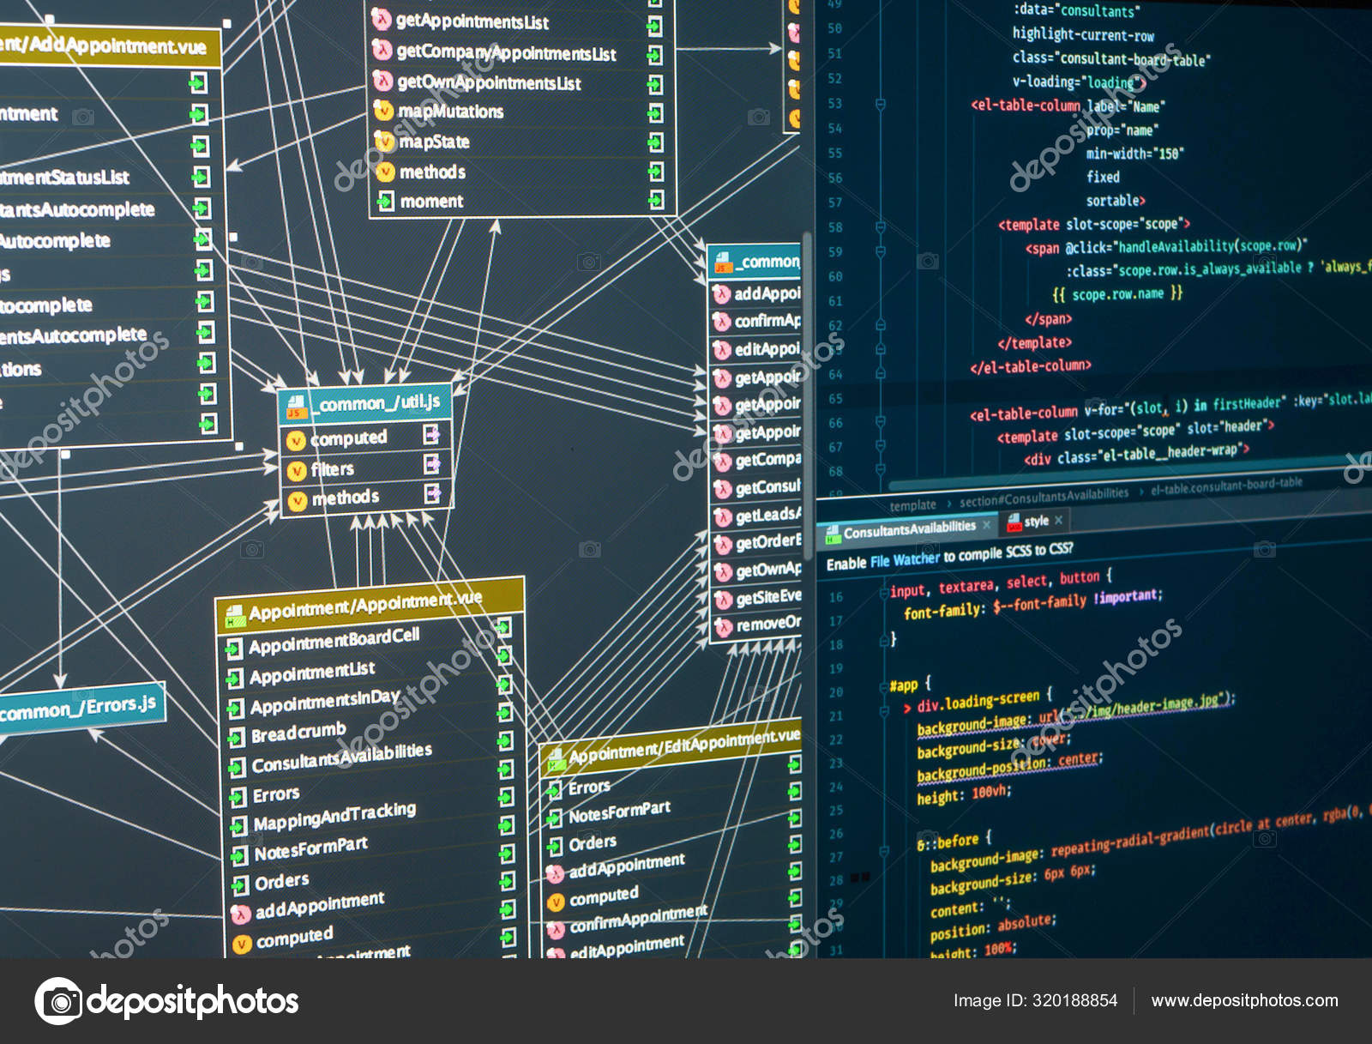
Group Theory in Database Theory:
Group theory is instrumental in ensuring data integrity and designing efficient database queries.
The idea of group transformations can help us understand the relationships between different entities in a database, which can lead to improved database design and operation.

Slide 13

Group Theory in Network Theory:
Network theory analyzes and visualizes connections between various entities.
Networks, including social networks, internet routing algorithms, or telecommunications networks, all have underlying structures that can be analyzed using group theory.
Understanding these structures can lead to more efficient network design and better performing algorithms.

Slide 14

Group Theory in Game Theory:
Game theory involves the study of mathematical models of strategic interaction among rational decision-makers.
Group theory can be used in game theory to analyze and solve problems.
By identifying symmetric situations and equilibrium points, group theory helps us to better understand and predict outcomes in various strategic games.

Slide 15
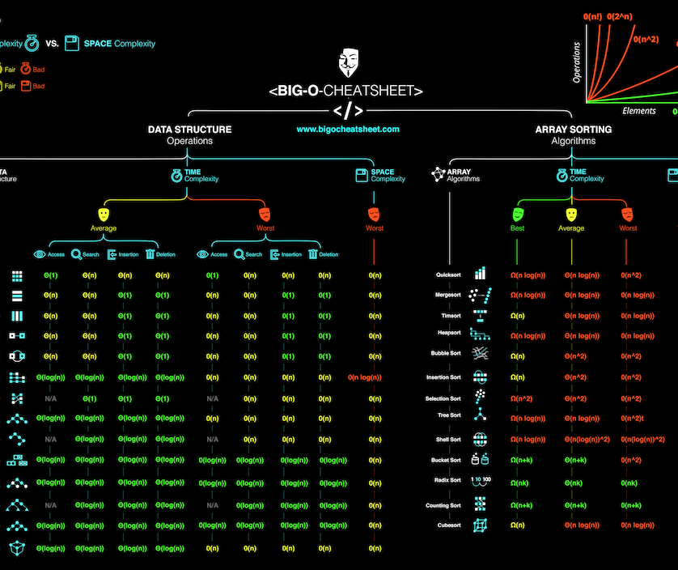
Group Theory in Complexity Theory:
Group theory also plays a vital role in understanding the complexity of problems and algorithms.
This includes the famous P vs NP problem and other issues related to computational hardness.
By providing a deep understanding of symmetries and transformations, group theory can provide unique insights into these challenging problems.

Slide 16

Group Theory in the Future of Computing:
Group theory will continue to be a significant tool in the future of computing.
It will be instrumental in emerging fields like quantum computing, nanotechnology, and bioinformatics.
As these fields continue to evolve and grow, the application of group theory will undoubtedly offer exciting new insights and solutions.

Slide 17

Discussion:
Let's discuss how you've used or could use group theory in your own work.
Are there places where recognizing symmetries or applying group transformations could make your algorithms more efficient or your data structures more robust?

Slide 18

Conclusion
Group theory is an indispensable tool in computer science that provides a powerful framework for solving problems in various fields, including data structures, cryptography, computer graphics, coding theory, quantum computing network theory, game theory, complexity theory, database theory, artificial intelligence and in future computing. By understanding the basic concepts of group theory and its unique connection to computer science, we can unlock new possibilities for innovation and discovery.

Slide 19

References and Q&A
References:
- Artin, M. (2011). Algebra (2nd ed.). Prentice Hall.
- Dummit, D. S., & Foote, R. M. (2004). Abstract algebra (3rd ed.). Wiley.
Gallian, J. A. (2017). Contemporary abstract algebra (9th ed.). Cengage Learning.
Q&A: Please feel free to ask any questions or share your thoughts about group theory and its applications in computer science.

